Slide 1
Engaging Youth as Partners to Improve Program Quality
Quality Action Efforts from the Minneapolis Beacons Network
Notes:
Introduce ourselves…our roles. Talk about how we will share our network’s experiences in our quality journey and how over time we have been able to partner more and more with youth in our work.
Before we get started we do want to get you interacting…intro everyone if group is small. Evolution…encourage to introduce selves and share that this is a metaphor for change over time

Slide 2
Minneapolis Beacons Network
Notes:
JWC
Introduce network-
partnership
Blah blah blah

Slide 3
Beacons Core Elements
Beacon Centers
Beacons Network
Ladders of Leadership
Family & Community Partnerships
The “Beacons Way”
Engaged Learning
Program Choices
Resource Development
Collective Vision
Data Driven Culture
City-Wide Youth Engagement
Cross Agency Professional Development
Notes:
JWC
Background on how we think about this work – these things guide our work within the network, and you’ll see how they connect to youth-adult partnership

Slide 4
Leadership Camp
Cross Agency Professional Development
City-Wide Youth Engagement
Engaged Learning
Ladders of Leadership
Notes:
SG
Invite & start to partnership
Planning – youth & adults, work for months, plan every aspect of camp together
Who comes to camp
Big Homies- Explain what’s happening in the photo – you have staff and hs staff walking with a group of young people, they’re walking to the amphitheater for the opening, which is also planned and facilitated by young people (Big Homies).

Slide 5
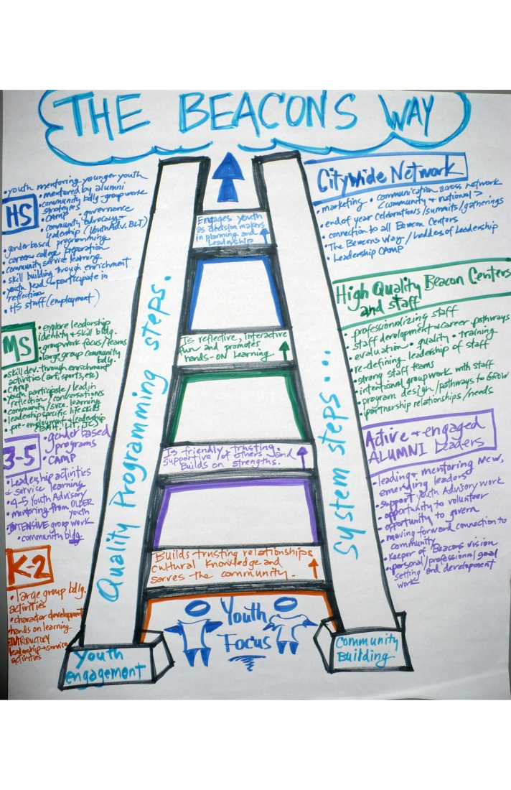
Ladders of Leadership
Center-based Leadership
Leadership focused groups/clubs
Youth Advisory
Citywide Youth Leadership
Beacons Leadership Team (BLT)
Beacons Leadership Camp
Other Beacons Network Events
Quality Action Team
Employment opportunities
Alumni Role
Notes:
SG
Continue “Camp” work in a more structured format at the centers and network wide.

Slide 6
Beacons Leadership Team (BLT)
Beacons Network
Set vision
Alumni
Beacon Center BLT Teams
Youth Advisory Groups
Convene meetings
Develop goals of BLT
Develop meeting agendas & traditions
Facilitate first meetings
Teams of youth and adults from each Beacon
Meet with citywide group monthly
Set vision, goals & projects for center
Build on plans made at BLT meetings
Execute activities and initiatives at center level
Team of youth and adults
High School or college-age youth partner with adults
Raise funds
Collective Vision
City-Wide Youth Engagement
Ladders of Leadership
The “Beacons Way”
Engaged Learning
Program Choices
Notes:
JWC
BLT is an example of creating a structure designed to engage youth as equal partners and we did this with quality improvement in mind from the start.
This explains how BLT was built – part of the design was to improve quality by modeling. Every meeting start with icebreaker, end with reflection, weave quality elements into sessions for staff and youth to practice leading them. Model for consistency, common language.

Slide 7
Quality Action Teams
Data Driven Culture
Cross Agency Professional Development
Ladders of Leadership
Family & Community Partnerships
The “Beacons Way”
Notes:
JWC
Which finally leads us to an effort we are currently doing that engages youth and adults in partnership to learn about the YPQA, assess programs using it, and inform quality improvement planning.
Explain the history and what is a QAT?

Slide 8
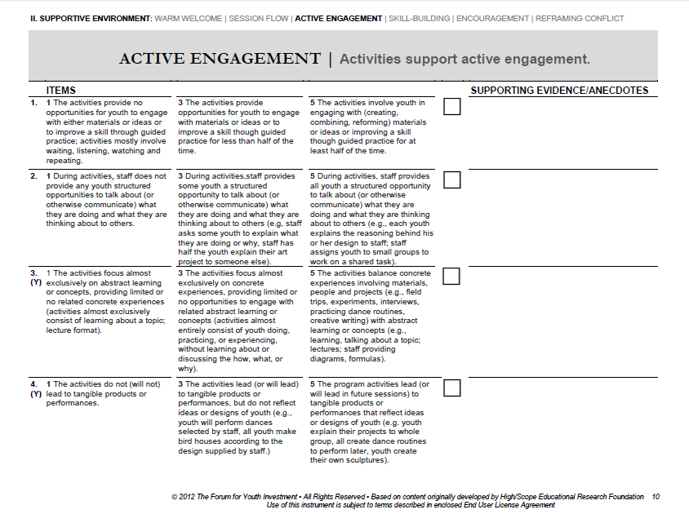
Notes:
SG
Here’s a page of the YPQA – lots of info, lots of detail, lots of confusing language
SO – in the interest of authentic partnership, we worked with a team of youth & adults to redesign the YPQA “The Beacons Way

Slide 9
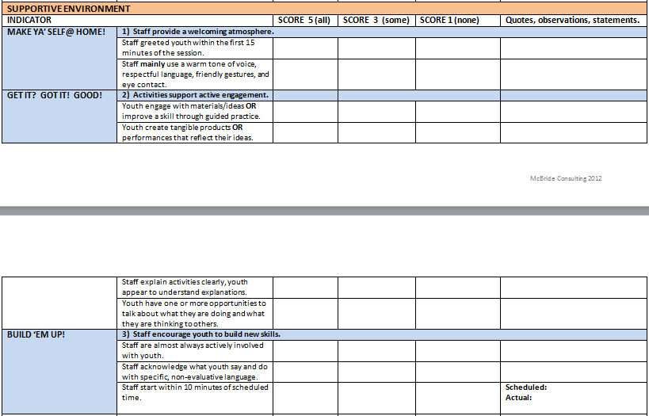
Notes:
SG
All Youth and adults are on the same footing with this tool – people should be equally reliable
You’ll see the same indicators under Get it? Got it! Good! This is just an excerpt from the Beacons tool.
Give some examples of how we then used that to train young people…and talk about how we do assessments.

Slide 10
Tips for Getting Started Engaging Youth in Quality Improvement
Invitation to partnership
Preparing youth and adults to partner
Create meaningful structures for partnership
Implement, Reflect & Plan
Notes:
JWC 11:30
Tips on getting started engaging youth to improve quality…Talk about training – Train on the old tool – Create new tool – Train on the new tool & how to assess program
How we use this with YPQA, but also with our planning/training for the quality teams
Share Successes & Challenges
Then ask for questions here?

Slide 11
Thank You!
Jenny Wright Collins
Beacons Network Director
Jenny.Collins@ymcatwincities.org
Stacey Guilfoyle
AmeriCorps Promise Fellow/ Beacons Alumnus
YMCA of the Greater Twin Cities
Annastasia.Guilfoyle@ymcatwincities.org
Notes:
Optional
SG-Focused Convo…tool we use for reflection. What Gut So What Now What
What (turn to partner if short on time…do only the what if not)—what is one word or image that stuck out to you today?
Gut—what was one thing about partnering with youth to improve program quality that you are excited about?
So what…where do you still have questions?
Now what…what resources would you/your org need to engage youth in improving quality?

